Slide 1
Secure Data Hiding in Image Using Steganography
CAPSTONE PROJECT
Presented By
Student Name : Yeshita Motwani
College Name & Department : D Y Patil International University, B. Tech CSE

Slide 2
OUTLINE
Problem Statement
Technology used
Wow factor
End users
Result
Conclusion
Git-hub Link
Future scope

Slide 3
Problem Statement
In the era of increasing cyber threats, ensuring secure data transmission is crucial. This project leverages steganography to embed encrypted messages within images and DOCX files, making the data invisible to unauthorized users. By implementing advanced encryption techniques, it enhances confidentiality and prevents data breaches. The system aims to provide a secure and efficient method for covert communication in cybersecurity applications.

Slide 4
Technology used
Technologies & Libraries Used:
Programming Language: Python
Libraries: OpenCV, Pillow, Stegano, Cryptography, Python-docx
Platforms: IBM SkillsBuild, Jupyter Notebook/PyCharm (for development)

Slide 5
Wow factors
1. Dual File Type Steganography (Images + DOCX)
Unlike many steganography projects that focus only on images, our also supports embedding encrypted data within DOCX files, adding an extra layer of versatility.
2. Hybrid Encryption with Steganography
Instead of just hiding data, the project uses cryptography (AES, RSA, or other encryption techniques) before embedding, ensuring double security—even if the hidden data is extracted, it remains unreadable without the decryption key.
3. Dynamic Payload Optimization
The system optimizes how much data can be securely embedded into an image or DOCX file without distortion, preventing detection while maintaining file integrity.
4. Secure Key-Based Extraction
Only authorized users with the correct decryption key can retrieve and access hidden information, adding an access control mechanism.
5. Practical Cybersecurity Use Cases
This project has real-world applications in covert communication, digital watermarking, and secure document transmission, making it highly relevant for cybersecurity.

Slide 6
End users
The end users of your Steganography-Based Secure Data Transmission System include:
1. Cybersecurity Professionals
Used for covert communication and secure data exchange in high-security environments.
Prevents data leaks by hiding sensitive information within images and documents.
2. Government & Defense Agencies
Used for classified communication to avoid interception.
Securely transmits intelligence without raising suspicion.
3. Corporate Organizations & Legal Firms
Protects intellectual property and confidential business documents.
Secures legal contracts and sensitive corporate data against cyber threats.
4. Ethical Hackers & Security Researchers
Used for penetration testing and understanding data hiding techniques.
Helps in anti-forensic research and improving steganography detection.
5. General Users Concerned About Privacy
Individuals who want to securely store or share personal documents.
Protects private messages from unauthorized access in a simple way.

Slide 7
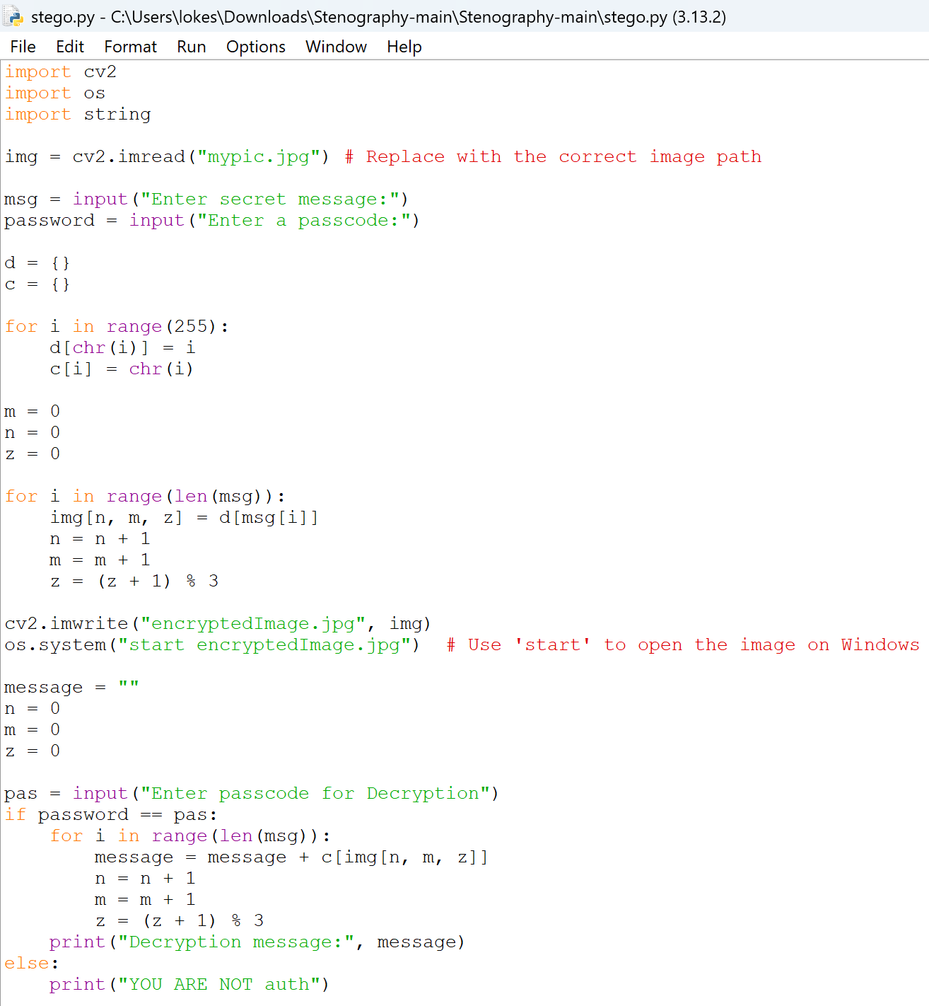
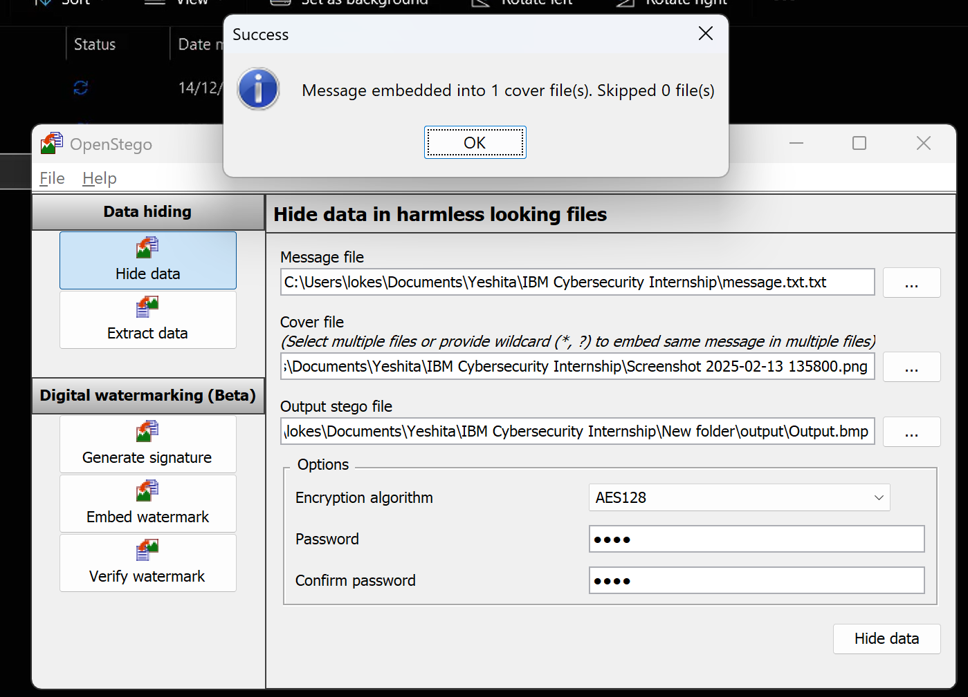
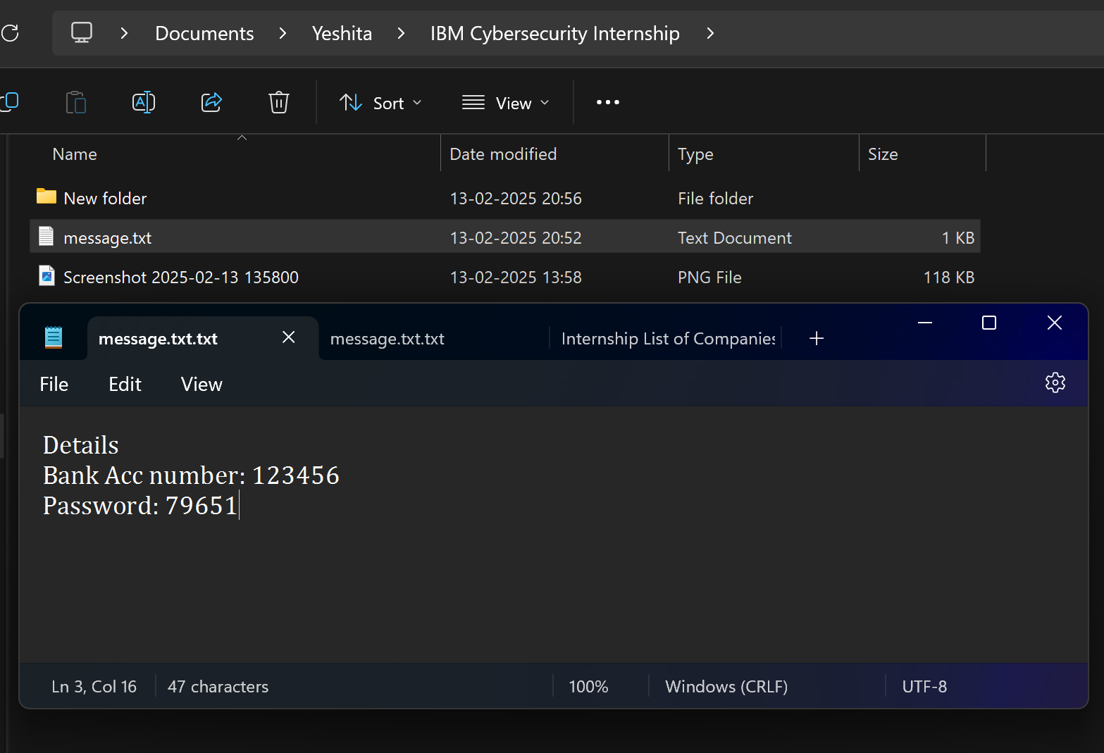
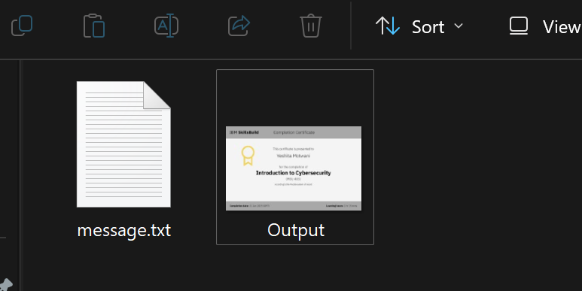
Results

Slide 8
Conclusion
This project successfully addresses the challenge of secure data transmission by integrating steganography and encryption to conceal sensitive information within images and DOCX files. By implementing hybrid encryption techniques, it ensures that even if the hidden data is extracted, it remains unreadable without proper authorization. The system provides an efficient, covert, and secure method for protecting confidential information from cyber threats.
With its dual file support, optimized payload management, and key-based access control, the project stands out as a practical solution for government agencies, corporate firms, cybersecurity professionals, and privacy-conscious users. It not only enhances data security but also showcases the importance of steganography in modern cybersecurity applications.

Slide 9
GitHub Link
https://github.com/YeshitaMotwani/IBM-Cybersecurity-Internship

Slide 10
Future scope(optional)
GUI-Based Web Application
Develop an interactive web app using React.js (frontend) and Flask/Django (backend) for user-friendly encryption and decryption.
Allow users to upload images and DOCX files, hide messages, and retrieve them securely through a simple interface.
Mobile App Integration
Extend the project to Android & iOS using React Native or Flutter, making secure steganography accessible on mobile devices.
Cloud-Based Secure Data Storage
Implement secure cloud storage where encrypted steganographic files can be uploaded and accessed with authentication.
Use AWS S3, Firebase, or IBM Cloud for scalability.
Multi-File Format Support
Expand beyond images and DOCX to include PDFs, audio, and video steganography, enabling broader use cases.
AI-Powered Steganalysis Resistance
Enhance the algorithm to evade AI-based steganalysis tools that detect hidden data in media files.
Blockchain for Secure Key Management
Use blockchain technology to store encryption keys securely, preventing unauthorized access and key tampering.
End-to-End Encrypted Messaging System
Develop a secure chat application that uses steganography for hidden communication, adding an extra layer of privacy.

Slide 11
THANK YOU

